Slide 1

Entrepreneurship Project
Kasani Amore, Kayla Schill, Rachel Worley

Slide 2
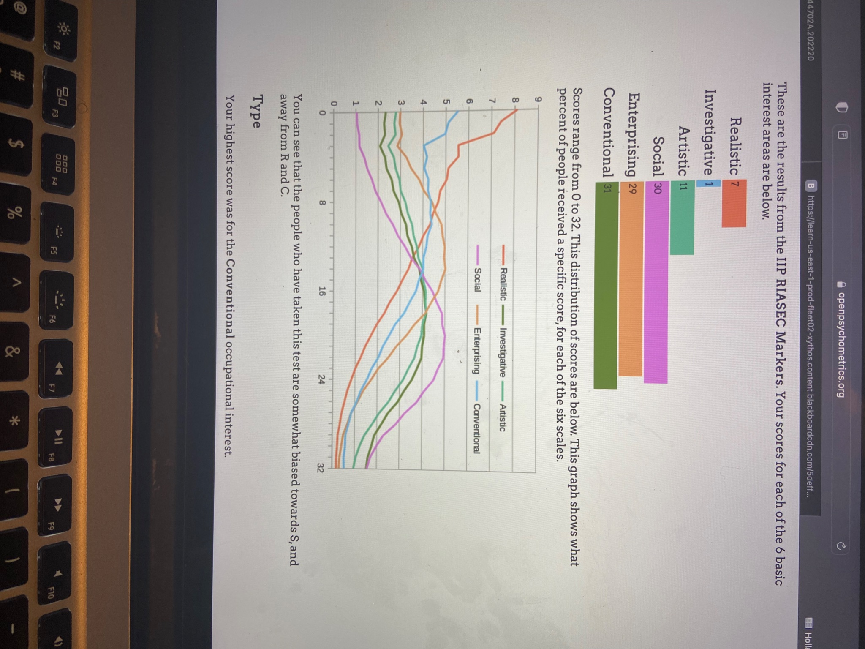
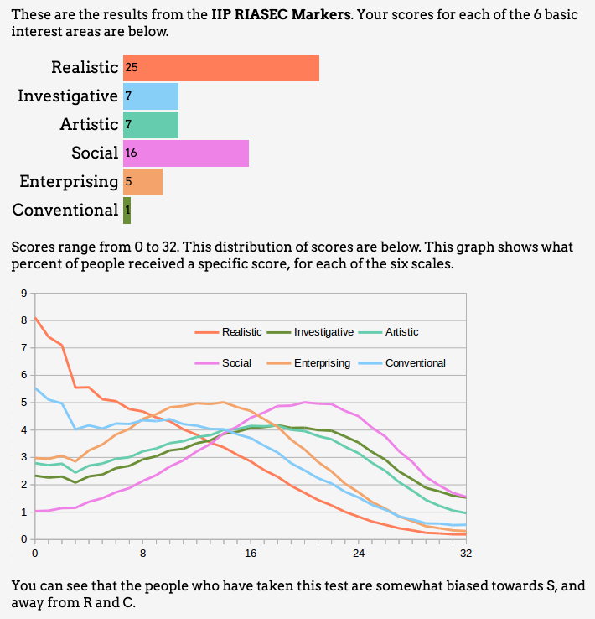
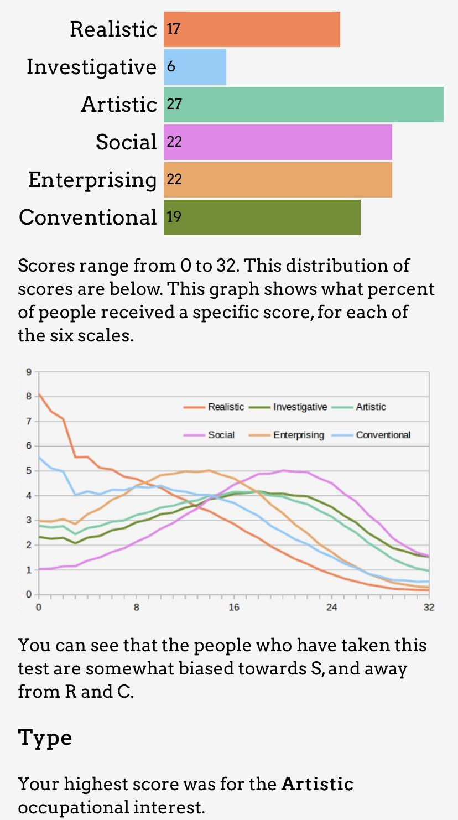
Background Research
After reviewing the results of our Holland Code Test, ((Holland Code (RIASEC) Test (openpsychometrics.org)), we were convinced that selecting IT Consulting with a target market of healthcare was our niche. The results were as follows:
Kasani
Kayla
Rachel

Slide 3

Business Idea Development
simpleCARE
Letterhead
Flyer
Bizcards
Part 2 - Google Drive

Slide 4
Resource Determination
Startup Capital: crowdfunding
Employees: 4 executives, 5 full or part-time employees or contractors
Physical Resources: Phones (VoIP & cellular), website, email, business cards, laptops and peripherals
CEO
CFO
COO
CTO
Accountant
Sales
HR
Data Analytics
Engineers

Slide 5
Financial Information
 | Q1 | Q2 | Q3 | Q4 | TOTAL
TOTAL INCOME | $69,186 | $71,594 | $72,442 | $75,736 | $288,958
TOTAL EXPENSES | $50,312 | $51,335 | $52,462 | $53,410 | $207,519
INCOME TAX | $3,964 | $4,254 | $4,196 | $4,688 | $17,102
NET INCOME | $14,910 | $16,005 | $15,784 | $17,638 | $64,337

Slide 6
What We Learned
Creativity is important when starting a business
Starting a business is not easy
Although difficult, being an entrepreneur pays off
It would be easier to have a partnership, as opposed to a sole proprietorship, so that the workload is more manageable
Animation Slide

Slide 7
Reflection - Kasani
I’m on the fence about whether I want to start my own business or not. I know it can be a lot of work, but I also know at the same time that the payoff can be way greater than if I were to just work for someone else for the rest of my life. I’ve considered starting my own real estate business, but I would most likely do that while I have another full-time job that I can fall back on. If my business is so successful that I do not have to work my other job anymore, then I will just be a full-time entrepreneur!

Slide 8
Reflection - Kayla
I have started my own businesses and it is simultaneously challenging and rewarding work. Some days you wish you worked for someone else because your current boss (you) is the worst boss you’ve ever worked for. Other days you are reminded why you started off on your own. I have no doubt I will continue to create and own businesses in my life as it affords a flexibility and freedom that no other job can offer.

Slide 9
Reflection - Rachel
Coming from a lineage of entrepreneurs, it has always been my desire to start my own business one day. I am aware of the amount of strength and fortitude it requires in order to become a business owner. My family has always instilled the importance of strength of mind and independence. I would love to have my own real estate business to carry out the legacy that my family has started and build upon that. Therefore, I am able to give back to my family as well as my community.

